Slide 1
Chapter 3: Wireless Local Area Networks

Slide 2
Objectives
Describe the features of the IEEE 802.11a/b/g/n/ac/ax WLANs
List the different types of client hardware
Describe the different functions of infrastructure devices

Slide 3
Sources of Standards
De facto standards: Common practices that the industry follows for various reasons
Ranging from ease of use to tradition to what majority of users do
Usually established by success in marketplace
QWER keyboard is an example
De jure standards: Official standards
Controlled by organization or body that has been entrusted with that task
TCP/IP mode Endorsed by the Internet Engineering Task Force (IETF)

Slide 4
IEEE working groups are as follows:
IEEE 802.11 – Wireless local area networking
IEEE 802.15 – Wireless personal area networking
IEEE 802.16 – Broadband wireless metropolitan area networks
IEEE 802.20 – Mobile broadband wireless access
IEEE 802.22 – Wireless regional area networks

Slide 5
IEEE 802.11-2020
To reduce confusion, in 2020 IEEE combined the standards and amendments into a single standard
The new, single standard specifies technical corrections and clarifications to the original
The IEEE specifically defines 802.11 technologies at the Physical layer and the MAC sublayer of the Data-Link layer.
IEEE 802.11-2020 Officially these retires all previous standards

Slide 6
802.11 Physical layer specifications
Infrared : uses a light-based medium. Although an infrared medium was indeed defined in the original 802.11 standard, it has since been deprecated and removed from the standard.
Frequency-hopping spread-spectrum (FHSS)
Direct-sequence spread-spectrum (DSSS)

Slide 7
IEEE 802.11
Specified that wireless transmission could take place via infrared (IR) or radio signals
Infrared Transmissions:
Can send data by the intensity of the infrared light wave
Light spectrum: All types of light
Infrared light: Can be used for wireless transmissions
Invisible
Emitter : Device that transmits a signal
Detector: Device that receives a signal

Slide 8
IEEE 802.11
Infrared transmissions (continued):
Transmissions can be either directed or diffused
Directed transmission: requires that the emitter and detector be directly aimed at one another in a line of sight (LoS) path
Diffused transmission: relies on reflected light
Emitters have a wide-focused beam instead of narrow and are pointed at a ceiling (reflection point)
Disadvantages include lack of mobility, limited range, confined to indoor use, slow transmission speed

Slide 10
Diffused infrared transmission

Slide 11
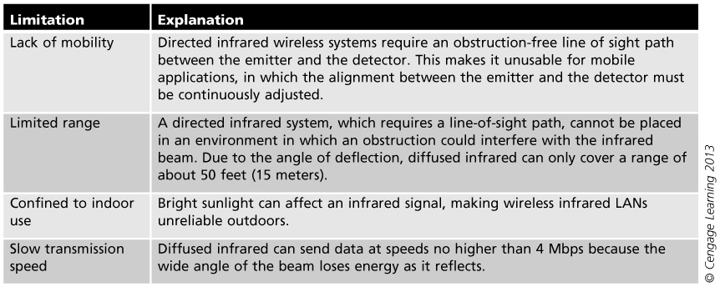
Limitations of infrared wireless systems

Slide 12
IEEE 802.11
Radio Wave Transmissions:
Radio waves can penetrate through objects
Provides mobility
Radio waves travel longer distances
Can be used indoors and outdoors
Radio waves can travel at much higher speeds than infrared transmissions
IEEE 802.11 standard outlining radio wave transmissions has become preferred method for wireless LANs

Slide 13
Types of Wireless LANs
Since late 1990s, IEEE has approved seven standards for wireless LANs:
IEEE 802.11
IEEE 802.11b
IEEE 802.11a
IEEE 802.11g
IEEE 802.11n (WIFI 4)
IEEE 802.11ac (WIFI 5)
IEEE 802.11ax (WIFI 6)

Slide 14
IEEE 802.11a -1999
802.11a and 802.11b published at same time
802.11a came to market later due to technical issues and high production cost
Uses 5GHz frequency
Specifies maximum rated speed of 54 Mbps using 64 Quadrature Modulation (QAM) modulation
it uses orthogonal frequency-division multiplexing (OFDM) , and Directs Sequence Spread Spectrum (DSSS) Spectrum
Range of 802.11a around 30 m

Slide 15
IEEE 802.11b 1999
Uses 2.4 GHz frequency
Specifies maximum rated speed of 11 Mbps using Complementary code keying (CCK-8bit)
High rate-direct sequence spread spectrum (HR/DSSS)
Supports wireless devices up to 107 meters
Radio waves decrease in power over distance
802.11b standard specifies that, when devices move out of range to transmit at 11 Mbps, devices drop transmission speed to 5.5 Mbps

Slide 16
IEEE 802.11g 2003
Effort to combine best features of 802.11a and 802.11b
Data transfer rates to 54 Mbps using 64 Quadrature Modulation (QAM) modulation
Support devices up to 115 meters
Uses 2.4 GHz frequency
Extended rate physical-orthogonal frequency division multiplexing (ERP-OFDM)

Slide 17
IEEE 802.11g configuration options

Slide 18
IEEE 802.11n-2009
Uses two bands, 2.4 GHz and 5 GHz
High-throughput orthogonal frequency division multiplexing (HT-OFDM)
Physical layer (PHY) layer enhancements and Data Link layer (MAC) layer enhancements
Data rates up to 600 Mbps 64 Quadrature Modulation (QAM) modulation
Introduce Multiple-input multiple-output technology (MIMO)

Slide 19
MIMO
IEEE 802.11a/b/g devices used a single radio to transmit and receive radio signals. This is known as single-input single-output (SISO) technology.
MIMO uses multiple radios to transmit and receive radio signals.
SISO systems are subject to multipath, in which several wavefronts of a signal would be received out of phase because of reflections. This is a problem for IEEE 802.11a/b/g systems, whereas MIMO actually uses the reflections from either a transmitter or a receiver to help enhance the performance and throughput using several radio chains in 802.11n.

Slide 20
IEEE 802.11ac-2013
Defines very high throughput (VHT) enhancements below 6 GHz
Uses 5 GHz bands
Data rates up to 6.9 Gbps using use 256-QAM modulation
Introduces the use of multi-user MIMO (MU-MIMO) technology

Slide 21
IEEE 802.11ax-2019
Introduce high efficiency (HE) WLAN
Operates in the 2.4 GHz, 5 GHz and 6 GHz frequency bands
A key component of 802.11ax is orthogonal frequency-division multiple access (OFDMA) technology
Data rates up to 9.6 Gbps using 1024-QAM modulation

Slide 22
WLAN Client Hardware
Wireless hardware and software can be divided into:
Wireless client network interface cards

Slide 23
Wireless Client Network Interface Card
Network interface card (NIC): Connects computer to network so that it can send and receive data
Today’s computers typically have NIC components built directly into the motherboard
NICs for wired networks have an RJ-45 connection used to connect the device to the network via a cable
Wireless NICs perform same function, but without wires
Categorized into wireless NIC devices for desktop computer and for portable devices

Slide 24
Network interface card for a wired network

Slide 25
Cards for Desktops
Internal wireless NICs have largely been replaced by external wireless NICs that plug into the Universal Serial Bus (USB) port
Desktop computers are now shipping with wireless NICs as standard equipment (along with a wired NIC)

Slide 26
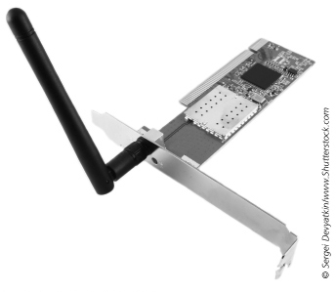
Internal wireless NIC

Slide 27
WLAN Infrastructure
Wireless network infrastructure:
Access points
WLAN bridges
WLAN repeaters
Gateways
Mesh Network
Power over Ethernet devices

Slide 28
Access Points (APs)
The wireless access point is an integral component of a WLAN infrastructure.
Wireless access points allow a variety of wireless client devices access to any network resources that the device or user may have permissions for.
An AP can operate as a stand-alone or It can also operate as part of a larger wireless, by sharing some of the same parameters, such as the service set identifier (SSID) which it is the logical name of the WLAN.

Slide 29
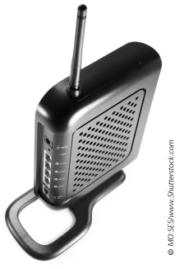
Access point

Slide 30
Access Points (APs)
Three major parts:
Antenna and radio transmitter/receiver
To send and receive signals
Special bridging software
To interface wireless devices to other devices
RJ-45 wired network interface
Allows it to connect to a wired network
Two basic function:
Base station for wireless network
Bridge between wireless and wired networks

Slide 31
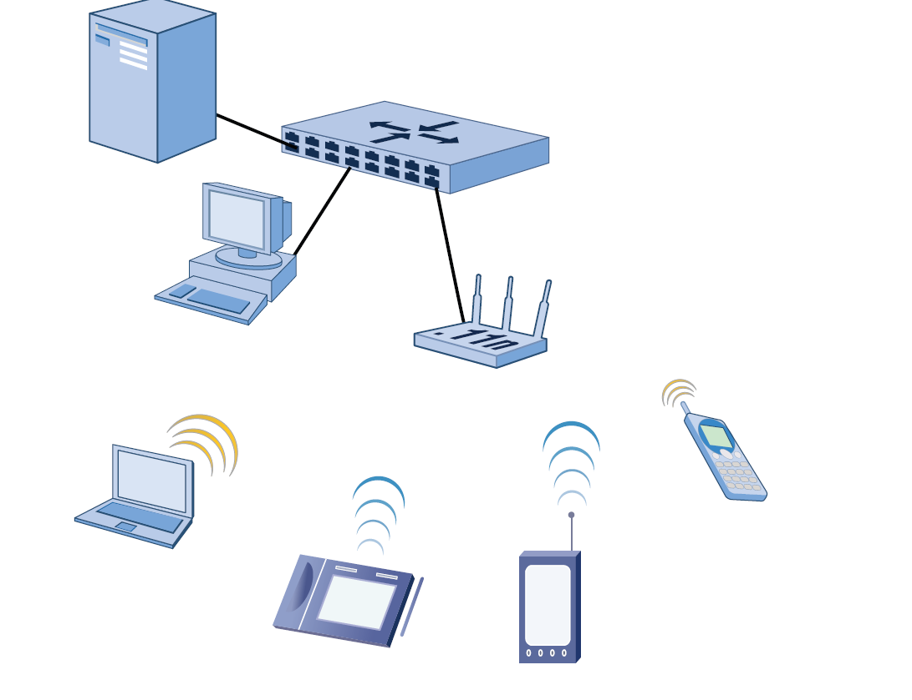
AP connected to wireless network

Slide 32
Types of Access Point (APs)
Autonomous Access Points also called Fat access point
Lightweight Access Points: also called thin access points or Controller managed
cloud-managed (or “controller-less”).

Slide 33
Access Point (APs)
Autonomous Access Points: standard APs
Considered independent because they are separate from other network devices
Have intelligence to manage authentication, encryption, and other functions for wireless clients
It is best suited for small networks with only a few access points or wireless hotspots, because they must be managed independently
Types of Autonomous AP
Consumer-grade;
small office, home office-grade (SOHO-grade)
enterprise-grade.

Slide 34
Autonomous Access Points
Autonomous Access Points usually include :
Network Address Translation (NAT)
Dynamic Host Configuration Protocol (DHCP)
Internet Protocol (IP) routing
Built-in firewall
SOHO Grade and enterprise Include Advanced security options Wireless bridge functionality and Wireless repeater functionality, and usually has much processing power

Slide 35
Lightweight Access Point (APs)
Lightweight Access Points: also called thin access points
Does not contain management and configuration functions, so they are not stand-alone devices
Those features are contained in a central device called wireless LAN controller (WLC) or wireless switch
WLC: distributes configuration information automatically to all lightweight access points

Slide 36
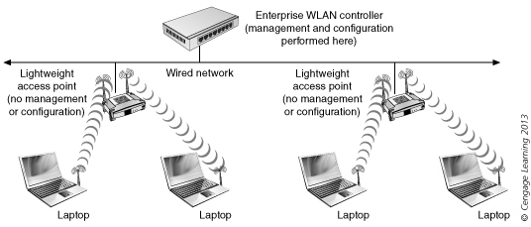
Lightweight access point with
enterprise WLAN controller

Slide 37
Cloud-Managed Access Point (APs)
Provides another solution for deploying WLAN infrastructures.
The access points are managed through a “cloud” software configuration tool, eliminating the need for a hardware controller.
Cloud-managed access points provide many of the same benefits and features of a WLAN controller solution without the need and extra expense of a hardware controller.

Slide 38
WLAN Bridges
Bridge: Connects two network segments together
Even if they use different types of physical media
Wireless workgroup bridge: used to connect a wired network segment to a wireless network segment
Remote wireless bridge: Connects two or more wired or wireless networks together that are separated by a longer distance using higher power and special antenna.

Slide 39
Wireless workgroup bridge

Slide 40
Point-to-point remote wireless bridge

Slide 41
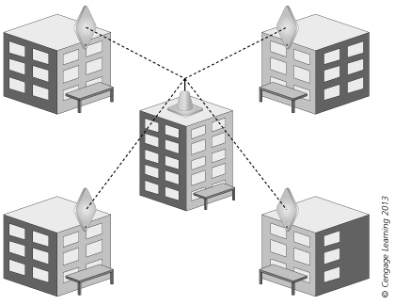
Point-to-multipoint remote wireless bridge

Slide 42
WLAN Repeaters
Repeaters Extend distance between WLAN
Repeaters function at Layer 1, so it cannot determine data traffic types and simply passes all data traffic across the device.
A wireless repeater provides the capability for computers and other devices to connect to a WLAN even when outside the normal hearing range of the access point connected to the network.

Slide 43
WLAN Repeaters

Slide 44
Wireless Mesh Networks
Wireless Mesh Network (WMN): when multiple mesh access points communicate between themselves
Mesh access point does not have to be individually connected by a cable to an existing wired network
Only one of the mesh access point in a WMN must be physically connected to the wired network

Slide 45
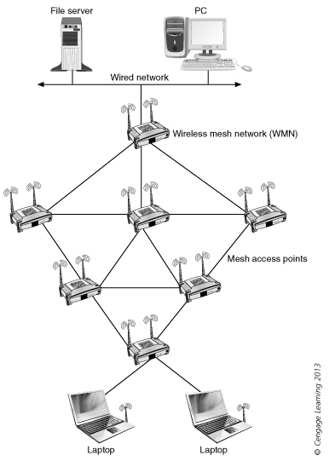
Wireless mesh network

Slide 46
Power over Ethernet (PoE) Devices
Devices that obtain power through the unused wires in a standard UTP Ethernet cable
Eliminates the need to install electrical wiring where devices might need to be located
PoE-enabled Ethernet switch: power sourcing equipment (PSE) that provides both electrical power and data
PoE injectors: can inject power into an Ethernet cable
A standard Ethernet switch can supply data while the PoE injector provides the power

Slide 47
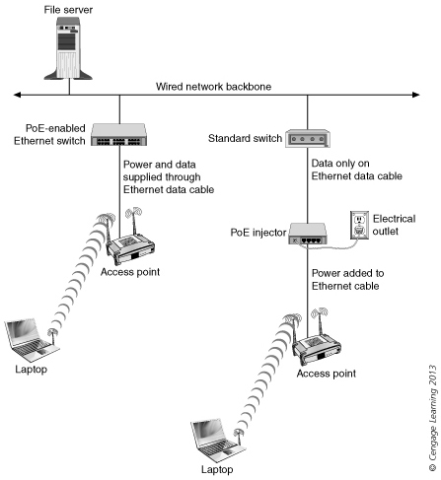
Power over Ethernet

